Slide 1
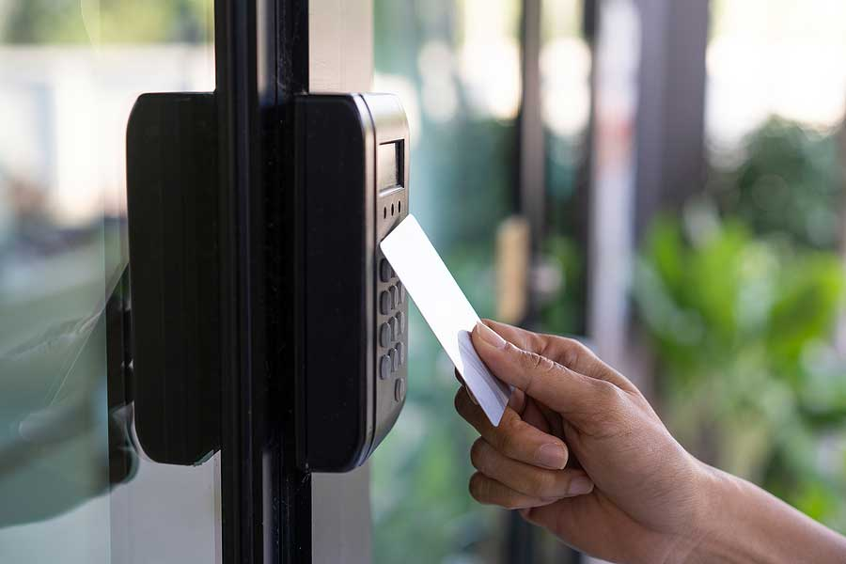
ATTENDENCE MARKING SYSTEM With Automatic Hand Sanitizer Dispenser

Slide 2
INTRODUCTION
The idea is to create an automatic attendance system with loT using RFID.
to track and manage real-time student attendance
By flashing their student card at the RFID reader, a system that can automatically record students' attendance can update a Google Sheet with that information.
A passive RFID radio-frequency identification (RFID) tag is attached to the student ID card, which is then compared to the database.
loT enables "things (objects)" to be sensed and controlled remotely across the Internet

Slide 3
Problem
It is a safe method with covid-19 situation
For the students, finding and signing their name on the attendance sheet takes time and is inefficient.
Some students may have purposefully or accidentally signed the name of another student, and the attendance record may got lost
Our recent attendance is not systematic as missing out the student name and false attendance record

Slide 4
Objectives
The RFID-based LoT Attendance System was created to achieve some of the following objectives:
To study the problem of current system in the proposed system
To develop a real time attendance system using RFID in loT with some covid-19 regulatins.
To test the functionality on how the system works

Slide 5

PROCESS MODEL

Slide 6

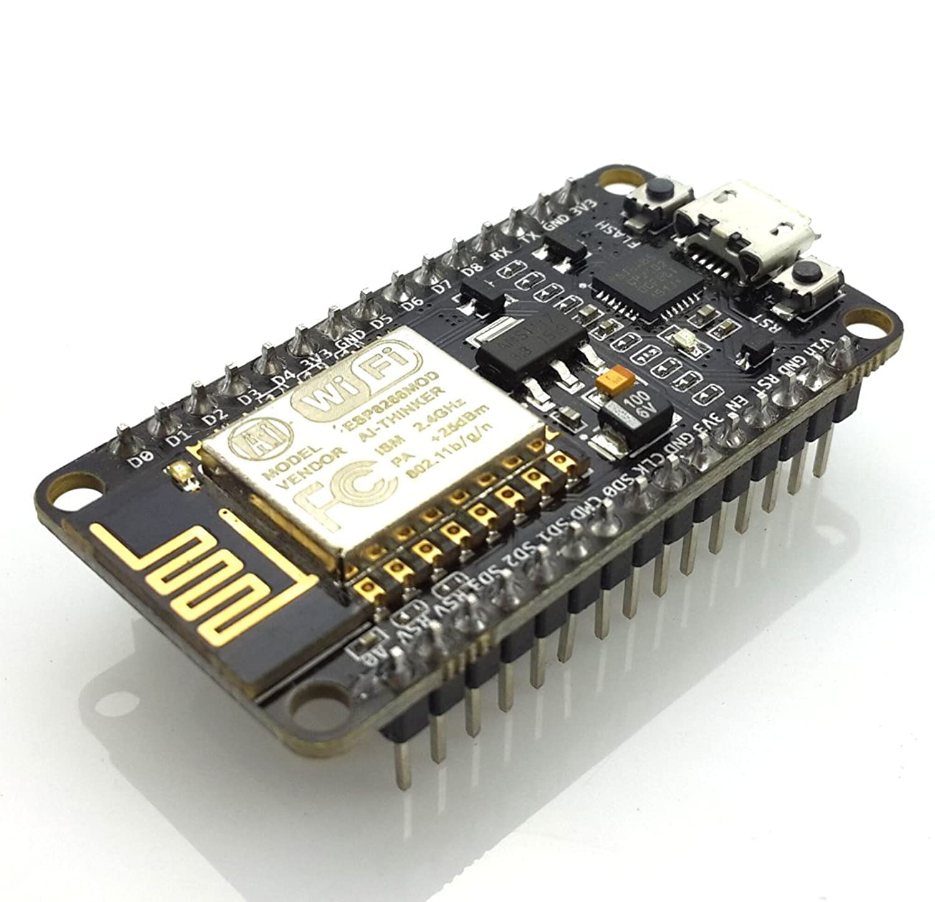


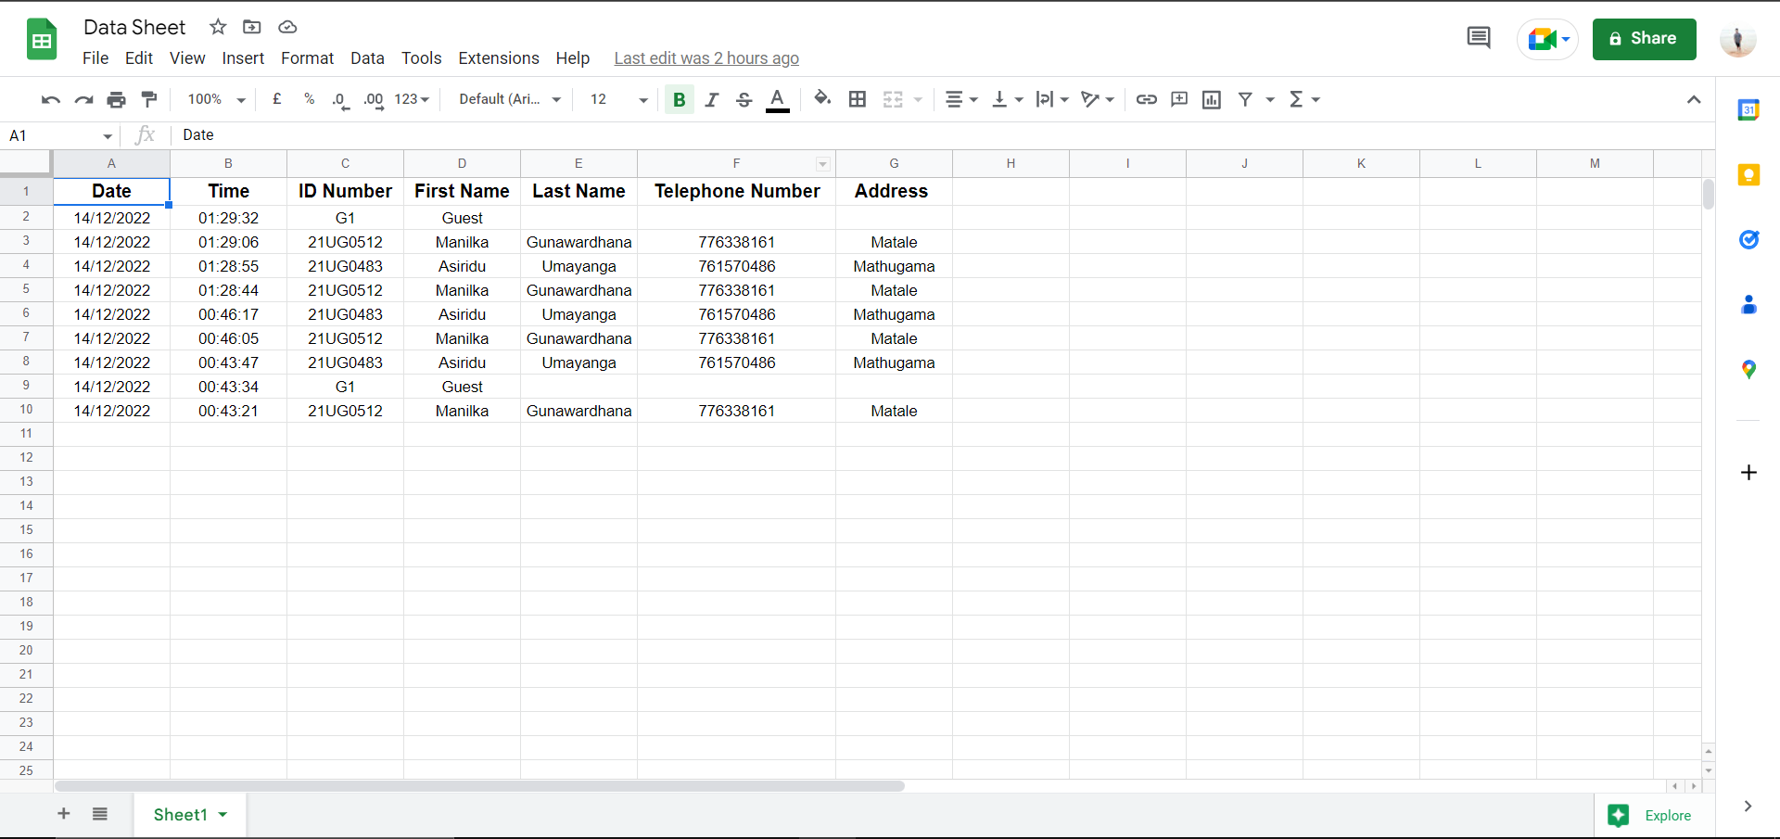

FRAMEWORK SYSTEM OVERVIEW
Connecting to Wi-Fi
RFID Reader
ESP8266
(IoT Board)
Sanitizing hands
Internet - Google Sheet
Marking in Google Sheet

Slide 7
DATA SHEET FOR ATTENDENCE

Slide 8

PROOF OF CONCEPT

Slide 9

ATTENDENCE MARKING SYSTEM

Slide 10
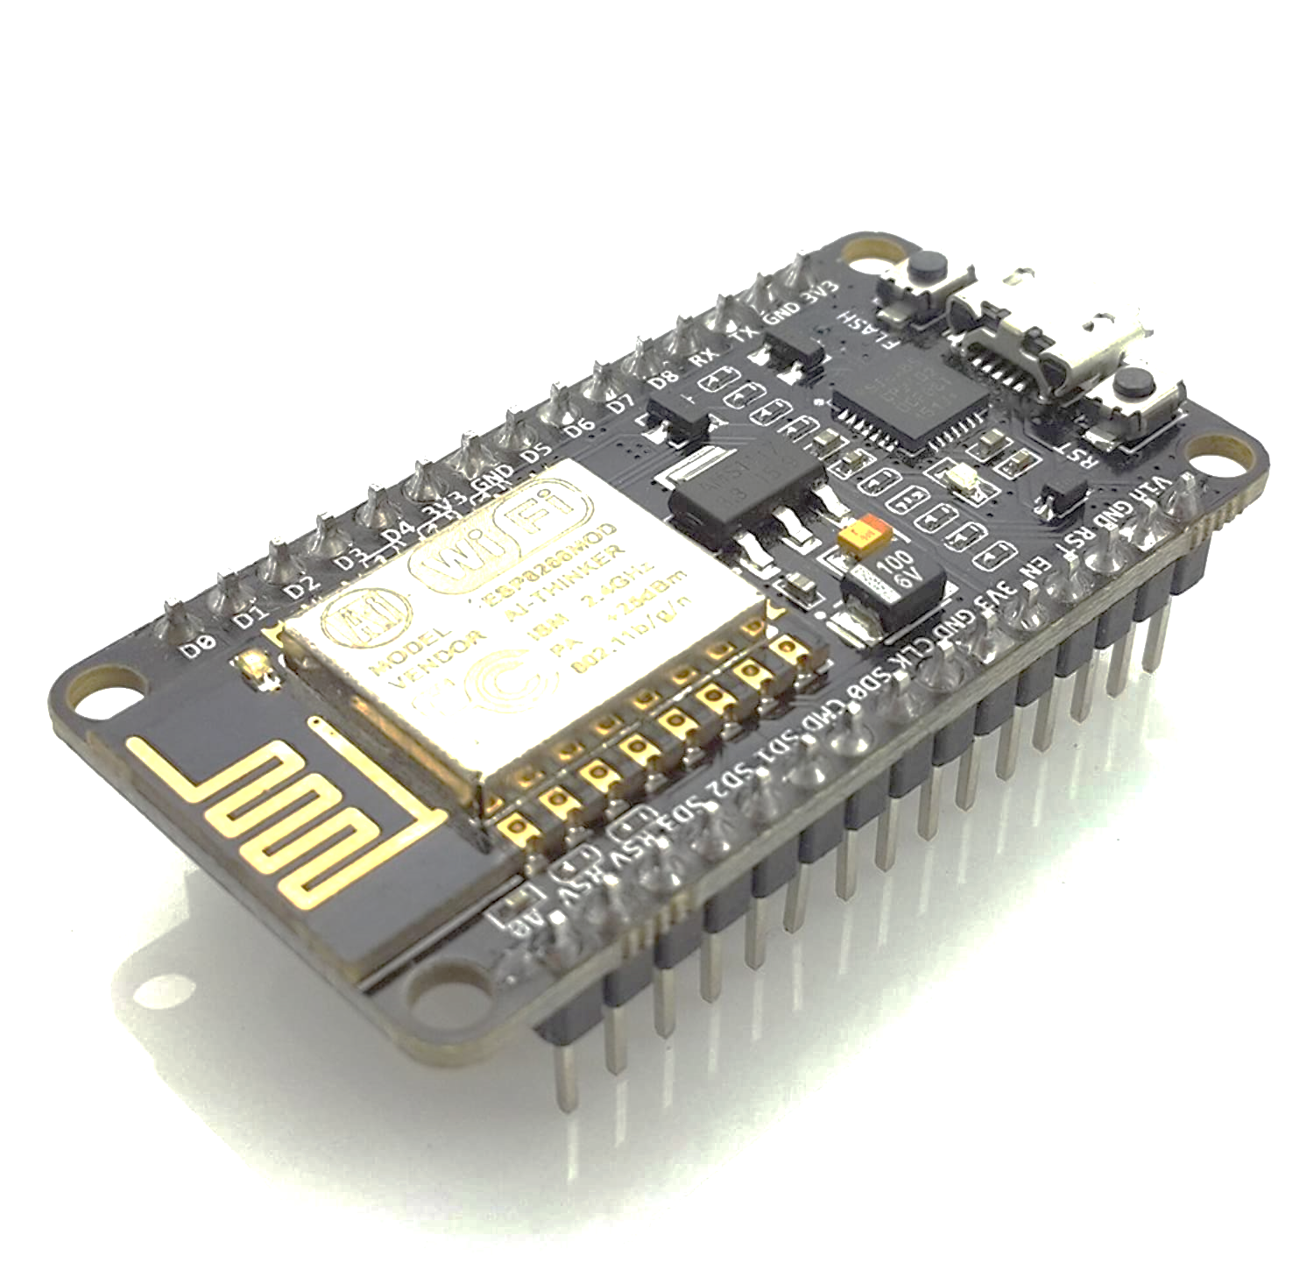
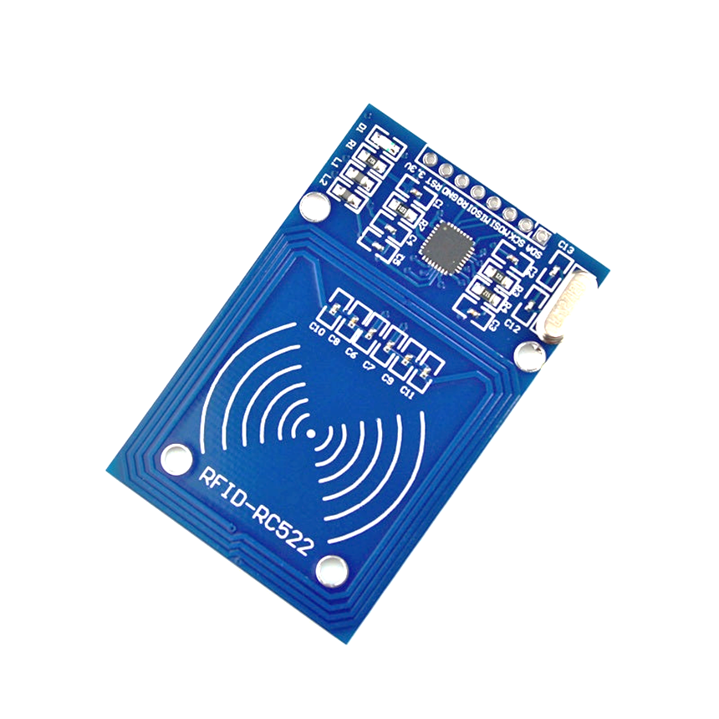
What Is an RFID or How does it work?
ESP8266 RFID reader using the MFRC522 module, and program the ESP8266 to provide access when the right card is detected
It will read the serial number on the Student Card and display itin the serial monitor

Slide 11

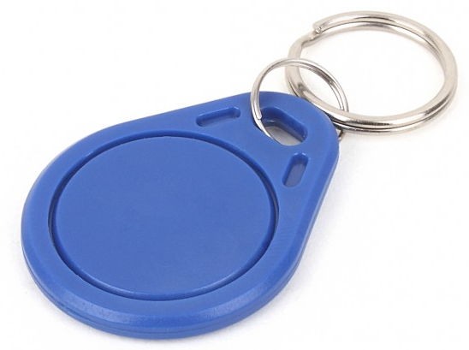
What’s RFID?
Radio-Frequency Identification (RFID) is the use of radio waves to read and capture information stored on a tag attached to an object
A tag can be read from up to several feet away and does not need to be within direct line-of-sight of the reader to be tracked

Slide 12
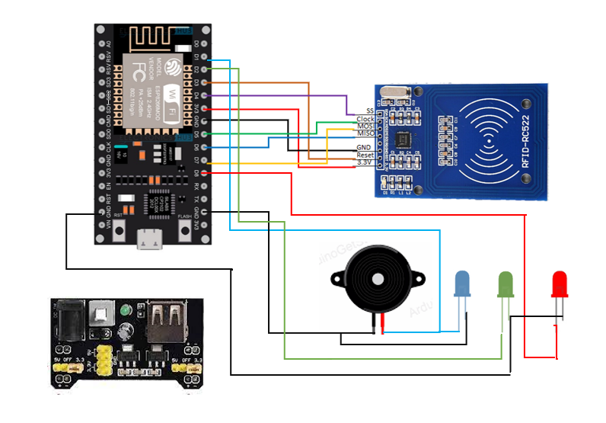
PROOF OF CONCEPT – SKETCH OFATTENDENCE MARKING SYSTEM

Slide 13
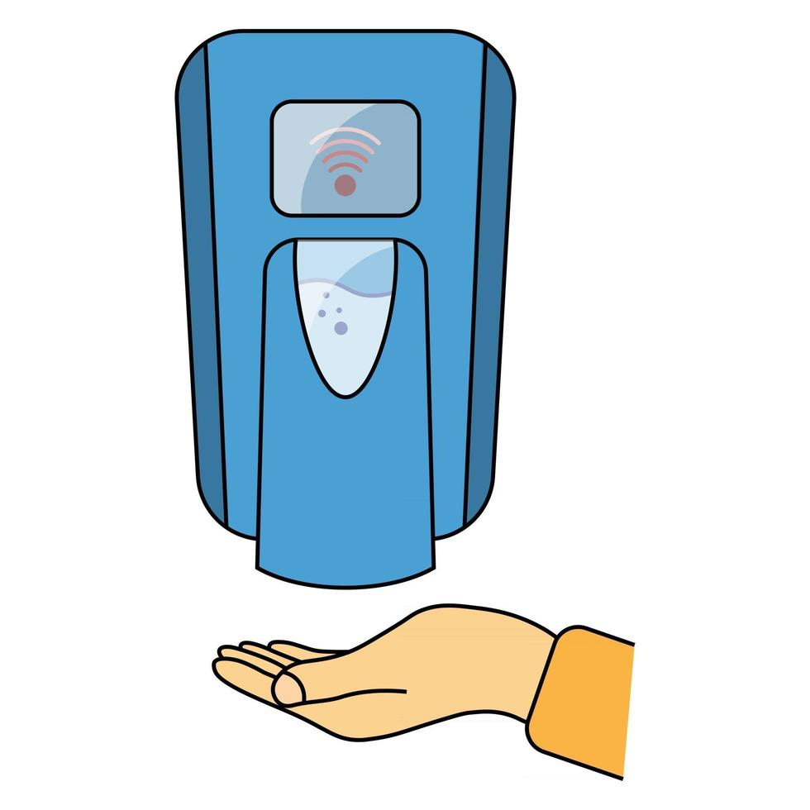
Automatic Hand Sanitizer Dispenser

Slide 14
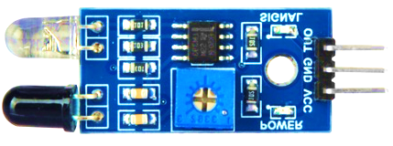
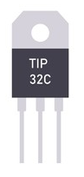
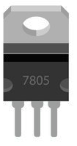
What Is is an IR sensor module
An electronic device that measures and detects infrared radiation in its surrounding environment.
What Is is an TIP32C
A silicon Epitaxial-base PNP power transistor in Jedec TO-220 plastic package. It is intented for use in medium power linear and switching applications.
.
What Is is an LM7805
A three terminal linear voltage regulator IC with a fixed output voltage of 5V which is useful in a wide range of applications.
.

Slide 15
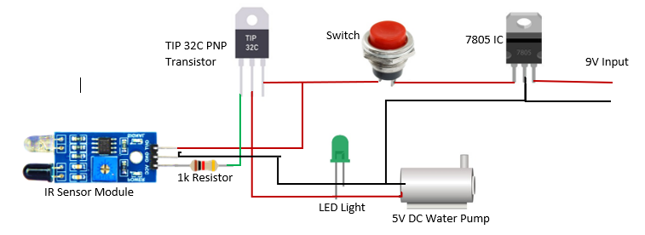
PROOF OF CONCEPT – SKETCH OF Automatic Hand Sanitizer Dispenser

Slide 16
Conclusion
An attendance marking system is a tool that is used to track and record the attendance of individuals in a specific space or location. This can be done through the use of various technologies, such as touchless scanners, RFID badges, or other methods. The system typically records the time and date of an individual's attendance, and can provide reports and analysis on attendance patterns and trends. In some cases, an attendance marking system may be integrated with other systems, such as payroll or time management software, to provide additional functionality and convenience. Overall, an attendance marking system can help organizations and institutions to better manage attendance and ensure that individuals are present when they are needed..

Slide 17

Questions..?

Slide 18


